Slide 1
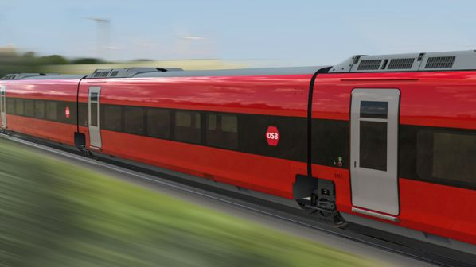
DSB: A Sustainable Mode of Transportation
Group 1: Christian, Jonas, Line and Tailor

Slide 2




DSB Future of Danish Mobility
DSB
Situation
Complication
Answer
Increase profitability
State-owned, but operates independently
Highly subsidised
Significant societal importance
Owns trains and operations
DSB should increase its revenue to foster growth through an increased comfort segmentation in trains and on stations, improved integration with last-mile transport options, and positive communication regarding punctuality and sustainability of DSB trains.
Negative reputation with some customers
Increasing customer expectations
Competition from passenger cars
Questions
How can DSB foster future profitable growth?
Executive Summary
Insights
Solution and Impact
Implementation
Risk and Mitigation
Summary
2

Slide 3
DSB Future of Danish Mobility
DSB
There is potential in these three, large customer segments…
and the reputation
Motivated light users
Unmotivated light users
Motivated non users
Public sentiment towards DSB is important
Little understanding of operation and complexity of task
Public sentiment often blames DSB for train-related issues
65-70% of delays are caused by unforeseen events or errors on tracks or signalling
98% of trains arrive within scheduled time
DSB play a critical role in Danish sustainability initiatives
Characteristics
Elder and married
Living in larger cities outside the capital region
High income and well-established
Live in smaller cities
More than 2 kilometers away from nearest train station
Finds public transportation limiting in general
Love their car
Live in smaller cities
More than 2 kilometers away from the nearest train station and work.
Take the car or the bus
Needs
Relaxed social surroundings
Flexibility and integration
Flexibility and integration
Revenue share
8 pct.
5 pct.
0 pct.
Executive Summary
Insights
Solution and Impact
Implementation
Risk and Mitigation
Summary
3

Slide 4

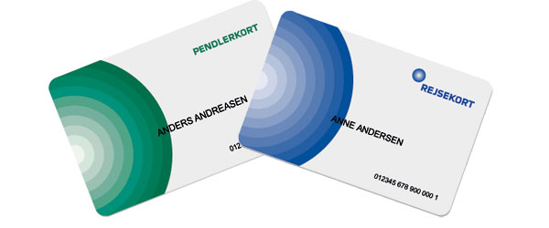
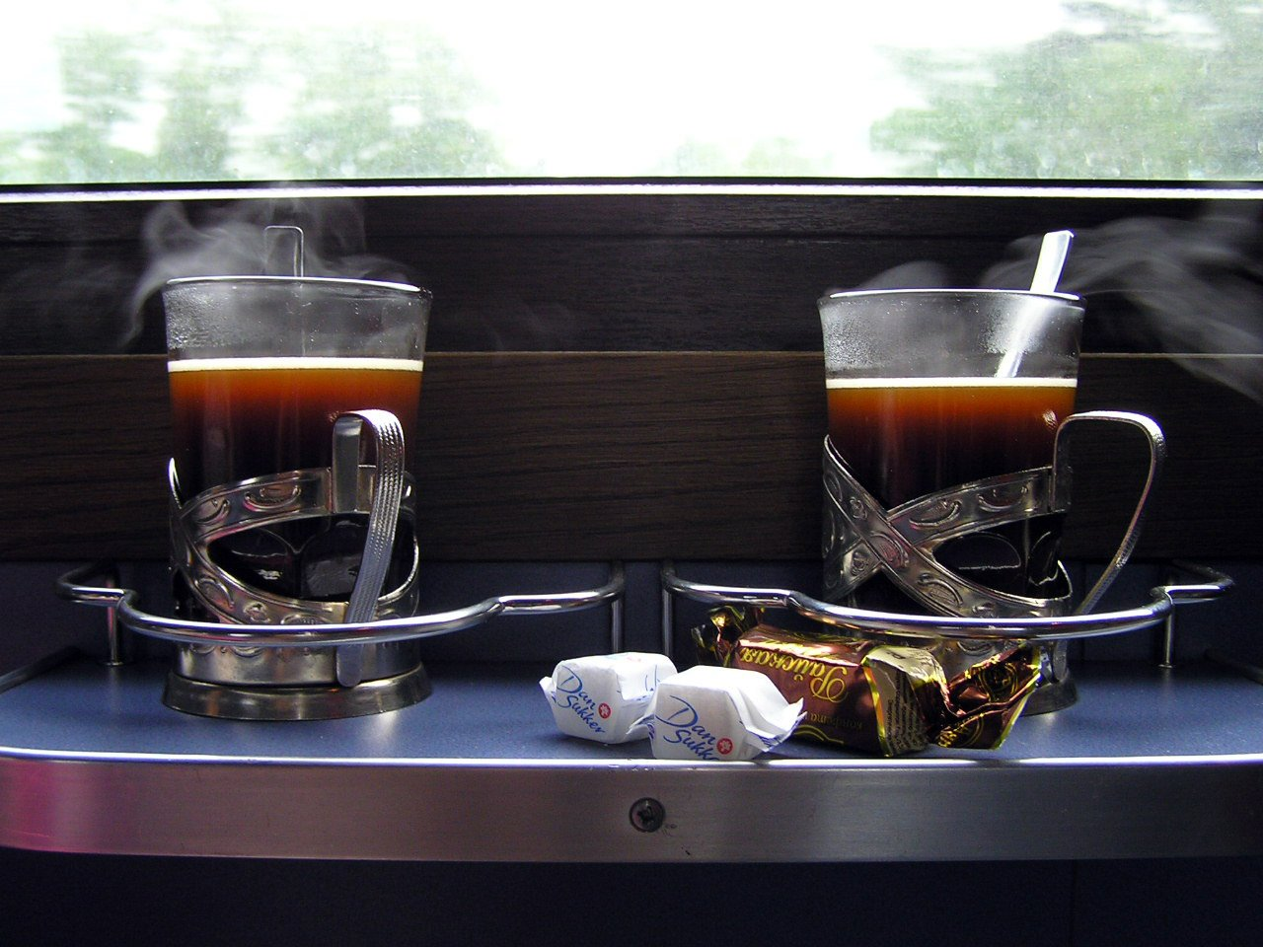
DSB Comfortability
33% of all passengers are ´Motivated light users’, but this segment amounts only of 5% of the total revenue.
To increase the revenue from this customer segment we suggest providing new paid comfortability options:
Customizable travel cards
Be able to buy coffee and and snacks on the S-train during rush hours.
Premium membership to get unlimited lounge access
DSB
Executive Summary
Insights
Solution and Impact
Implementation
Risk and Mitigation
Summary
4

Slide 5


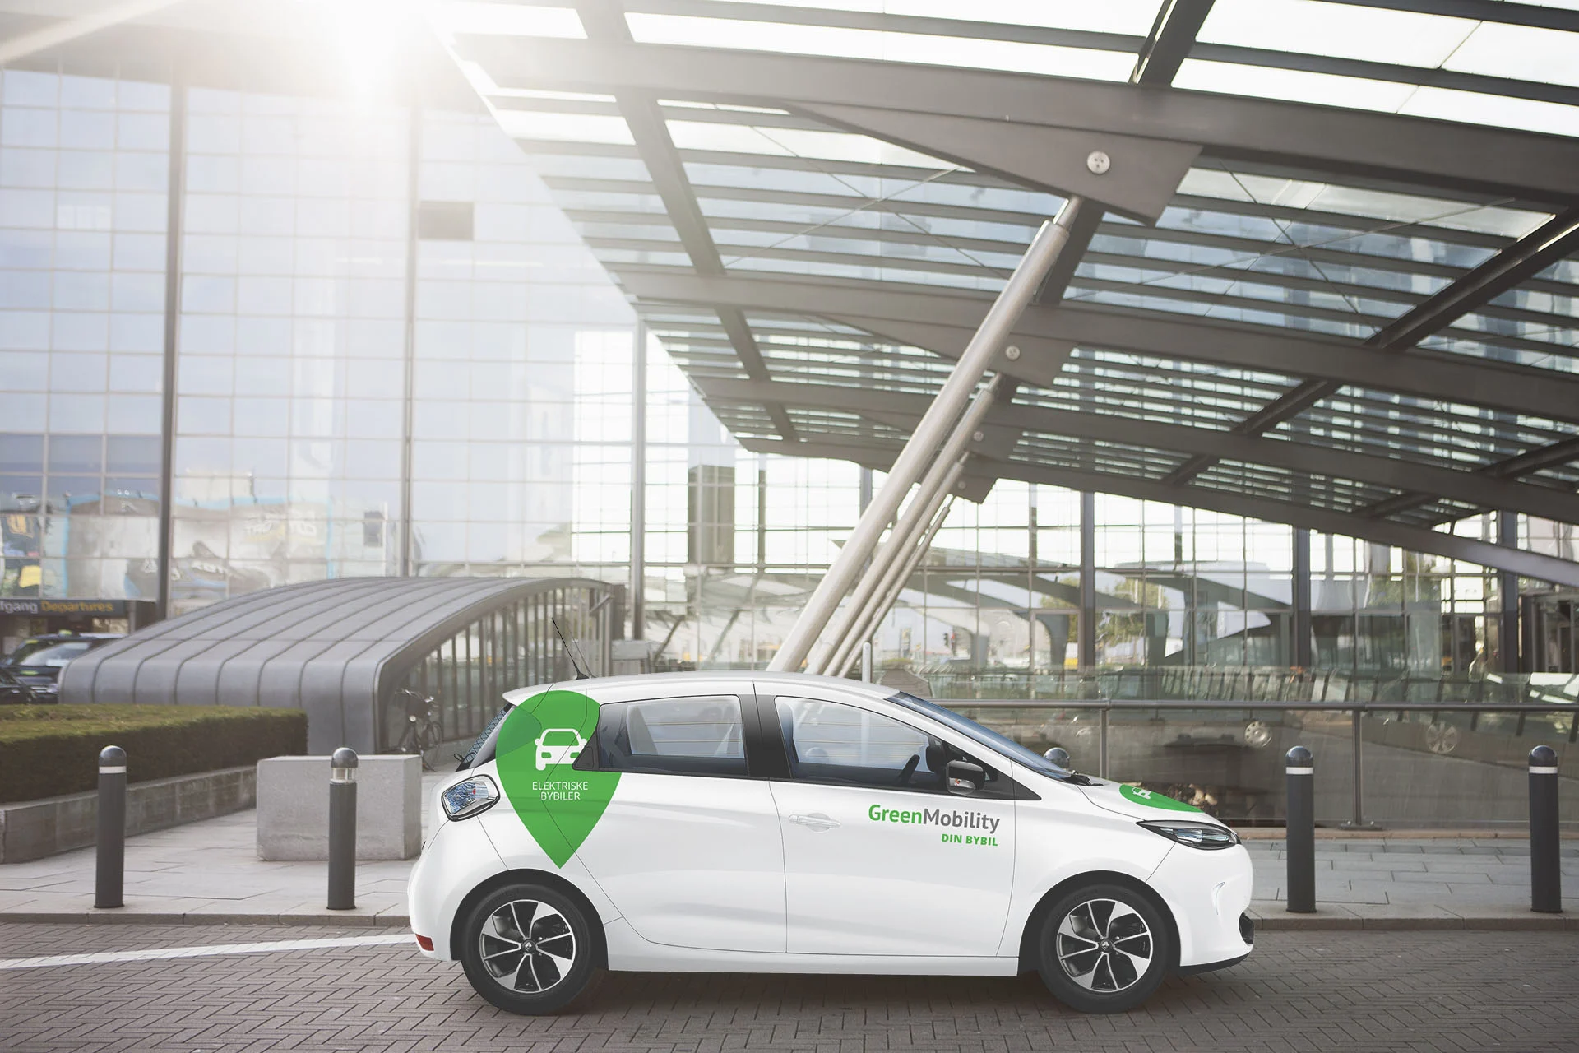
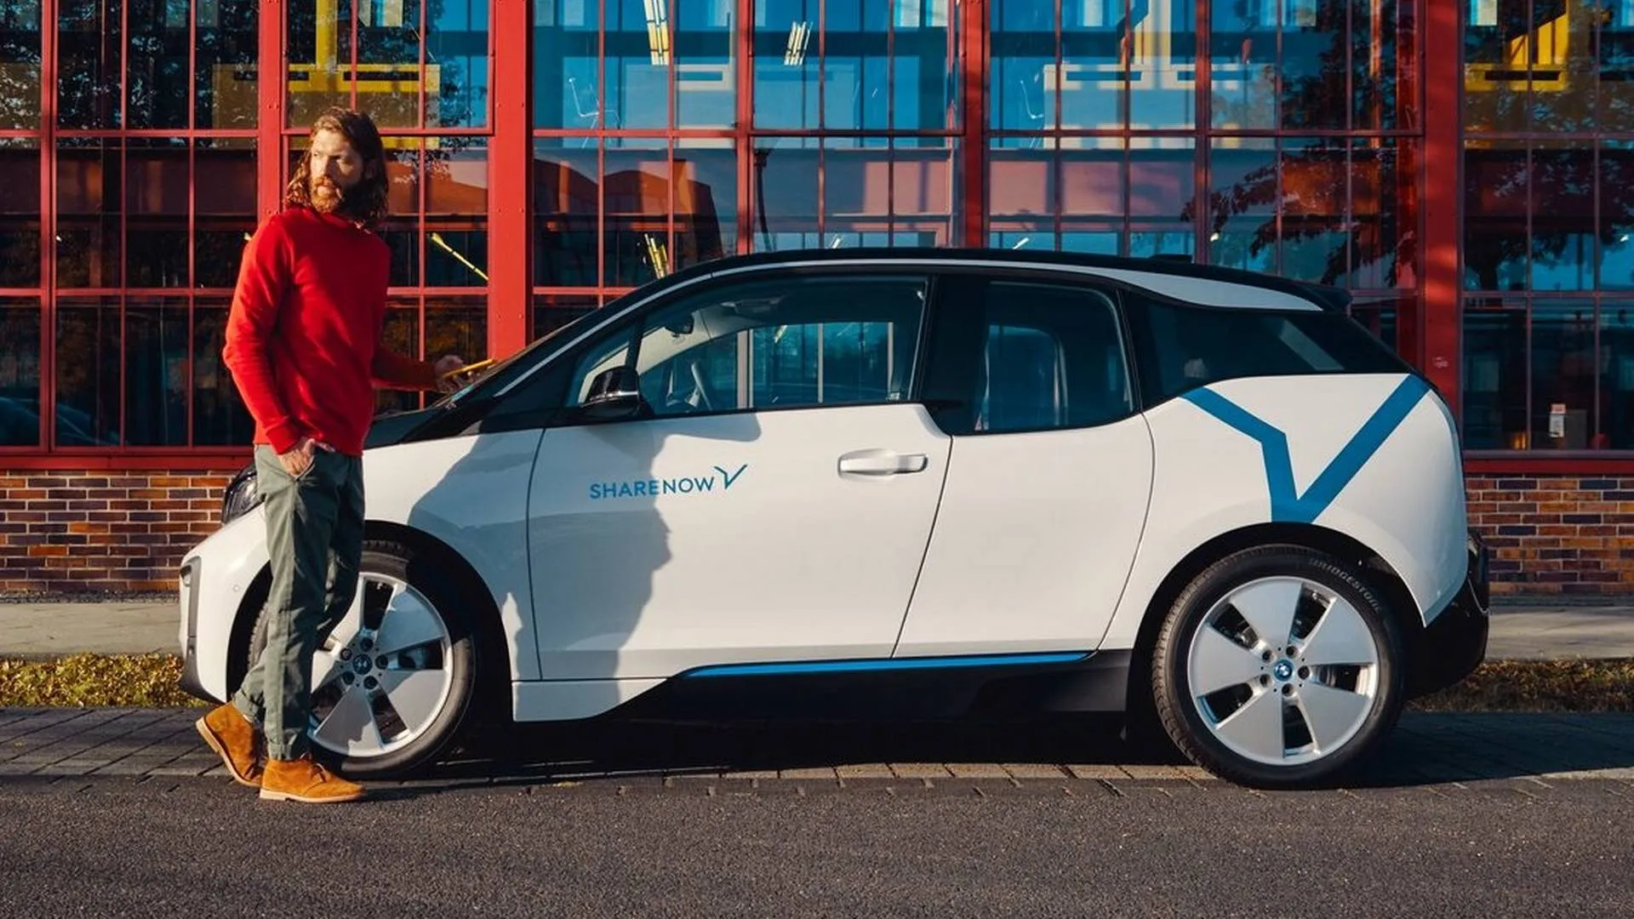
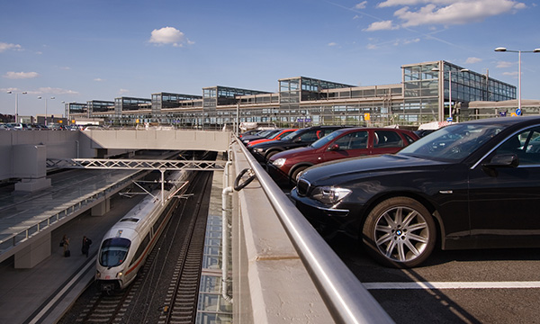
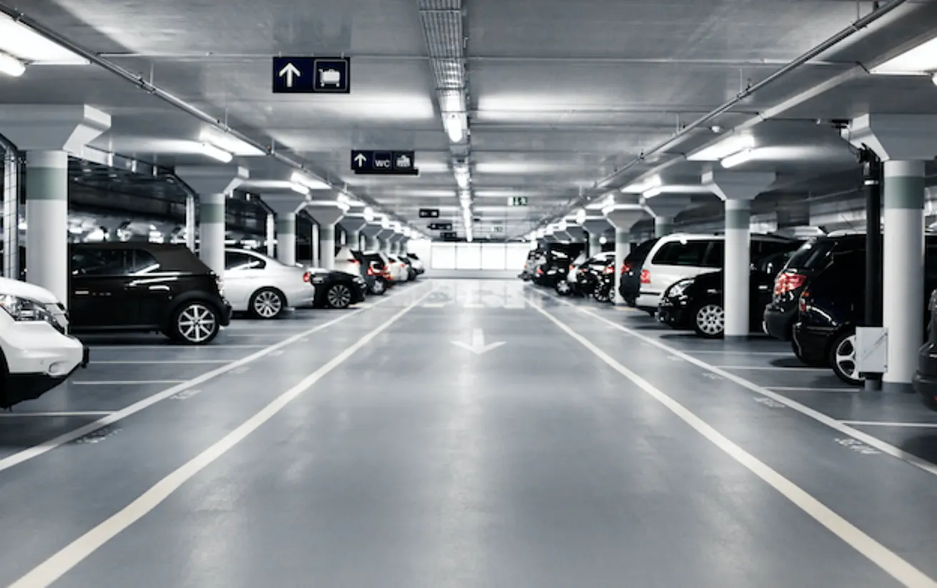
Integration
DSB
28% of all passengers are ´Unmotivated light users’, but this segment amounts only of 8% of the total revenue.
To increase the revenue from this customer segment we suggest providing better integration options:
Partnerships with car-sharing provider
More collaboration with bus companies
Better parking options/deals at train stations
Executive Summary
Insights
Solution and Impact
Implementation
Risk and Mitigation
Summary
5

Slide 6


Reputation
DSB
41 % of the Danish population are ‘non users’, who do not take DSB transport at all
To draw more people in from this customer segment we need to improve the reputation of DSB:
Campaigns with focus on:
SDGs
Data comparing public transport in Denmark with other EU countries
Focus on money-back guarantee for being late
Targeted user surveys
Executive Summary
Insights
Solution and Impact
Implementation
Risk and Mitigation
Summary
6

Slide 7
DSB Future of Danish Mobility
DSB
Action Tracks
2024
2025
2026
Explorative Track
Setting up continuous evaluation system
Execution
Targeted Surveying & Research Programme
Motivated light-user
Unmotivated light-users
Motivated non-users
Targeted Survey
Survey X Act – Better understand our target groups
Learning & Innovating: New Interventions, Services & Products
Development of Info-Campaign
Launch
Evaluate & Redesign
Launch
Evaluate & Redesign
Intervention Track
Future Interventions
Motivated light-users
COMFORT + PROGRAMM
Unmotivated light-users
Partnerships & Last Mile Integration Programs
Motivated non-users
Executive Summary
Insights
Solution and Impact
Implementation
Risk and Mitigation
Summary
7

Slide 8
Future mobility: Risks mitigated through strategic planning
DSB
Threat
Risk
Mitigation
Probability
1
Customers do not pay for increased comfort
Carry out a survey in advance, with focus on motivated light users
2
Competition from buses that offer cheaper travel
Communication with focus on sustainability
3
2
3
Providing a platform to competitors through partnership
Communication – with focus on sustainability of trains vs cars
4
Segmentation removes space from ‘regular’ customers
Allowing for use of ‘comfort areas’ by everyone in rush hour – with priority for ticket holders
1
5
5
Move towards standardization of operations across the EU
Operational flexibility in relation to trains moving across borders
4
Impact
Executive Summary
Insights
Solution and Impact
Implementation
Risk and Mitigation
Summary
8

Slide 9
DSB Future of Danish Mobility
DSB
Situation
Complication
Answer
Increase profitability
State-owned, but operates independently
Highly subsidised
Significant societal importance
Owns trains and operations
DSB should increase its revenue to foster growth through an increased comfort segmentation in trains and on stations, improved integration with last-mile transport options, and positive communication regarding punctuality and sustainability of DSB trains.
Negative reputation with some customers
Increasing customer expectations
Competition from passenger cars
Questions
How can DSB foster future profitable growth?
Executive Summary
Insights
Solution and Impact
Implementation
Risk and Mitigation
Summary
9

